Slide 1
Circus Corona
My personal journey through a nightmare
TRUTH SEEKER-TV Oslo, 03/01-22
Heiko Santelmann, M.D. from Oslo, Norway drheiko@me.com
www.DocHeiko.eu

Slide 2
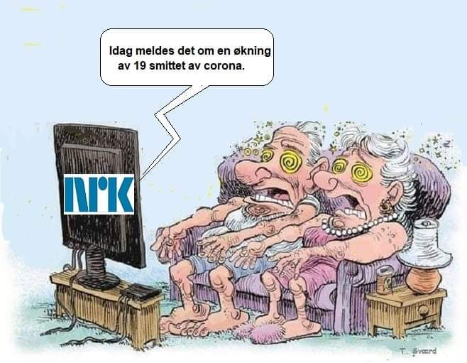
Fear is the virus

Slide 3
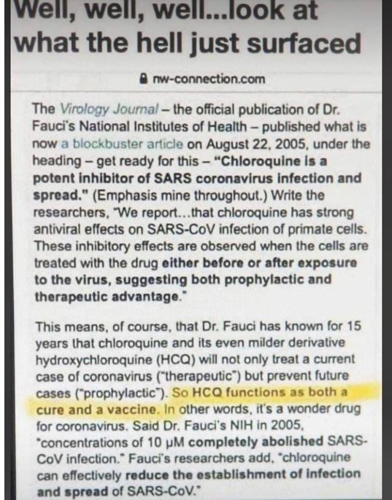
Dr. Fauci APPROVED Hydroxychloroquine 15 Years Ago To Combat Coronaviruses

Slide 4
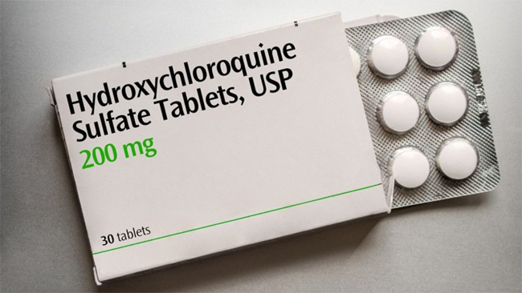

Slide 5
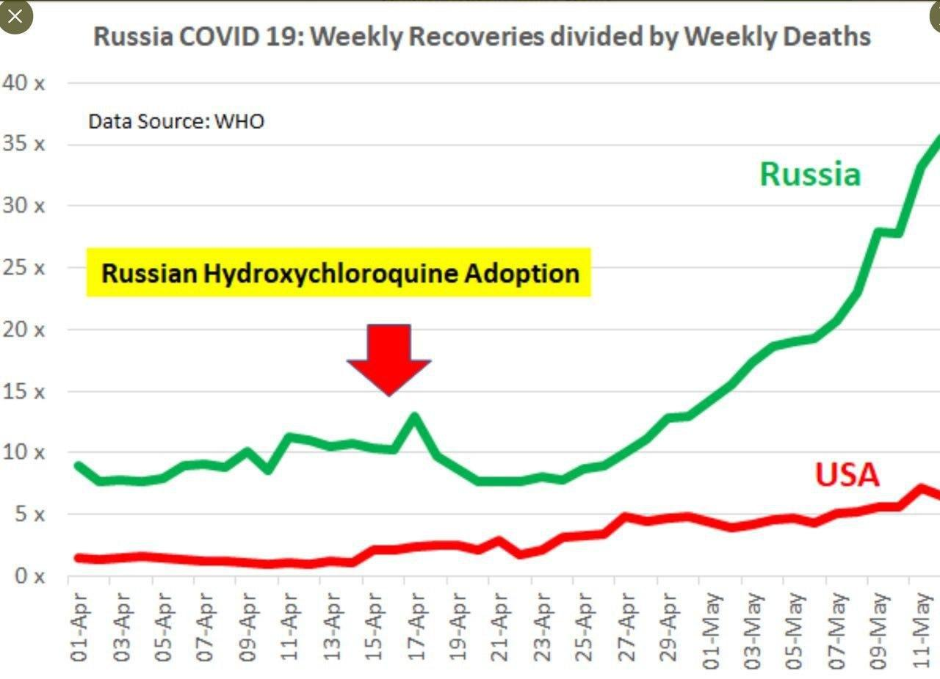

Slide 6
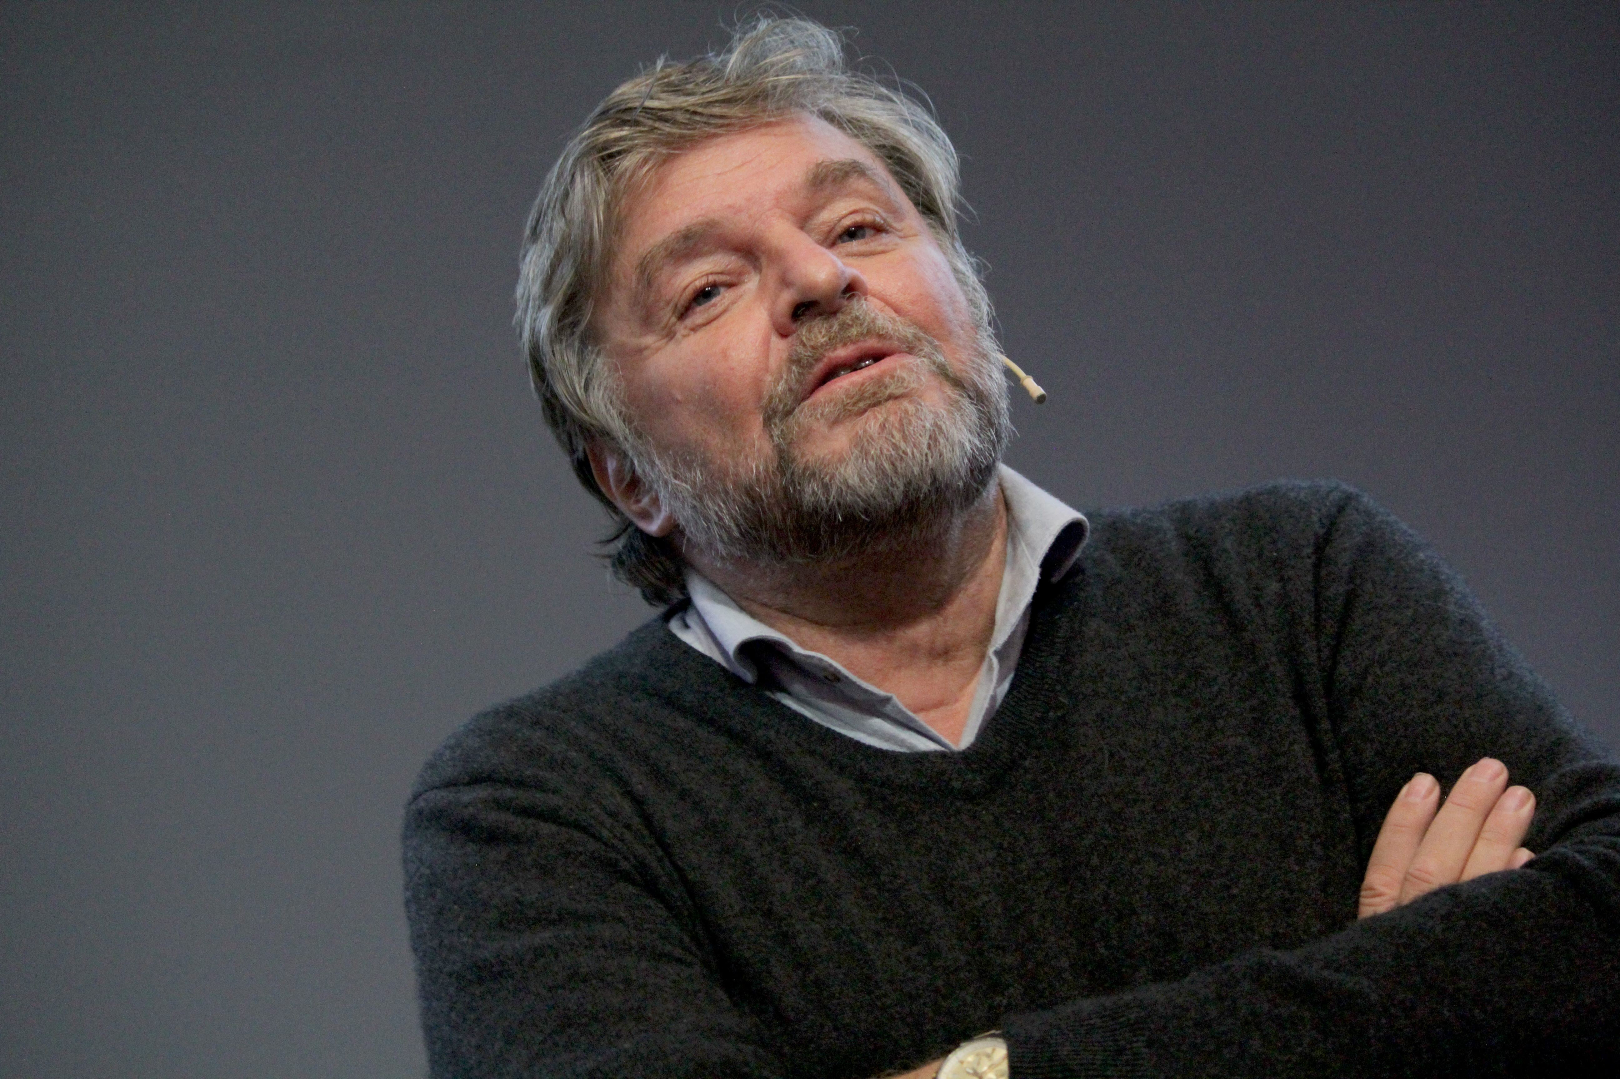
Steinar Madsen, medical director at the Norwegian Medicines Agency

Slide 7
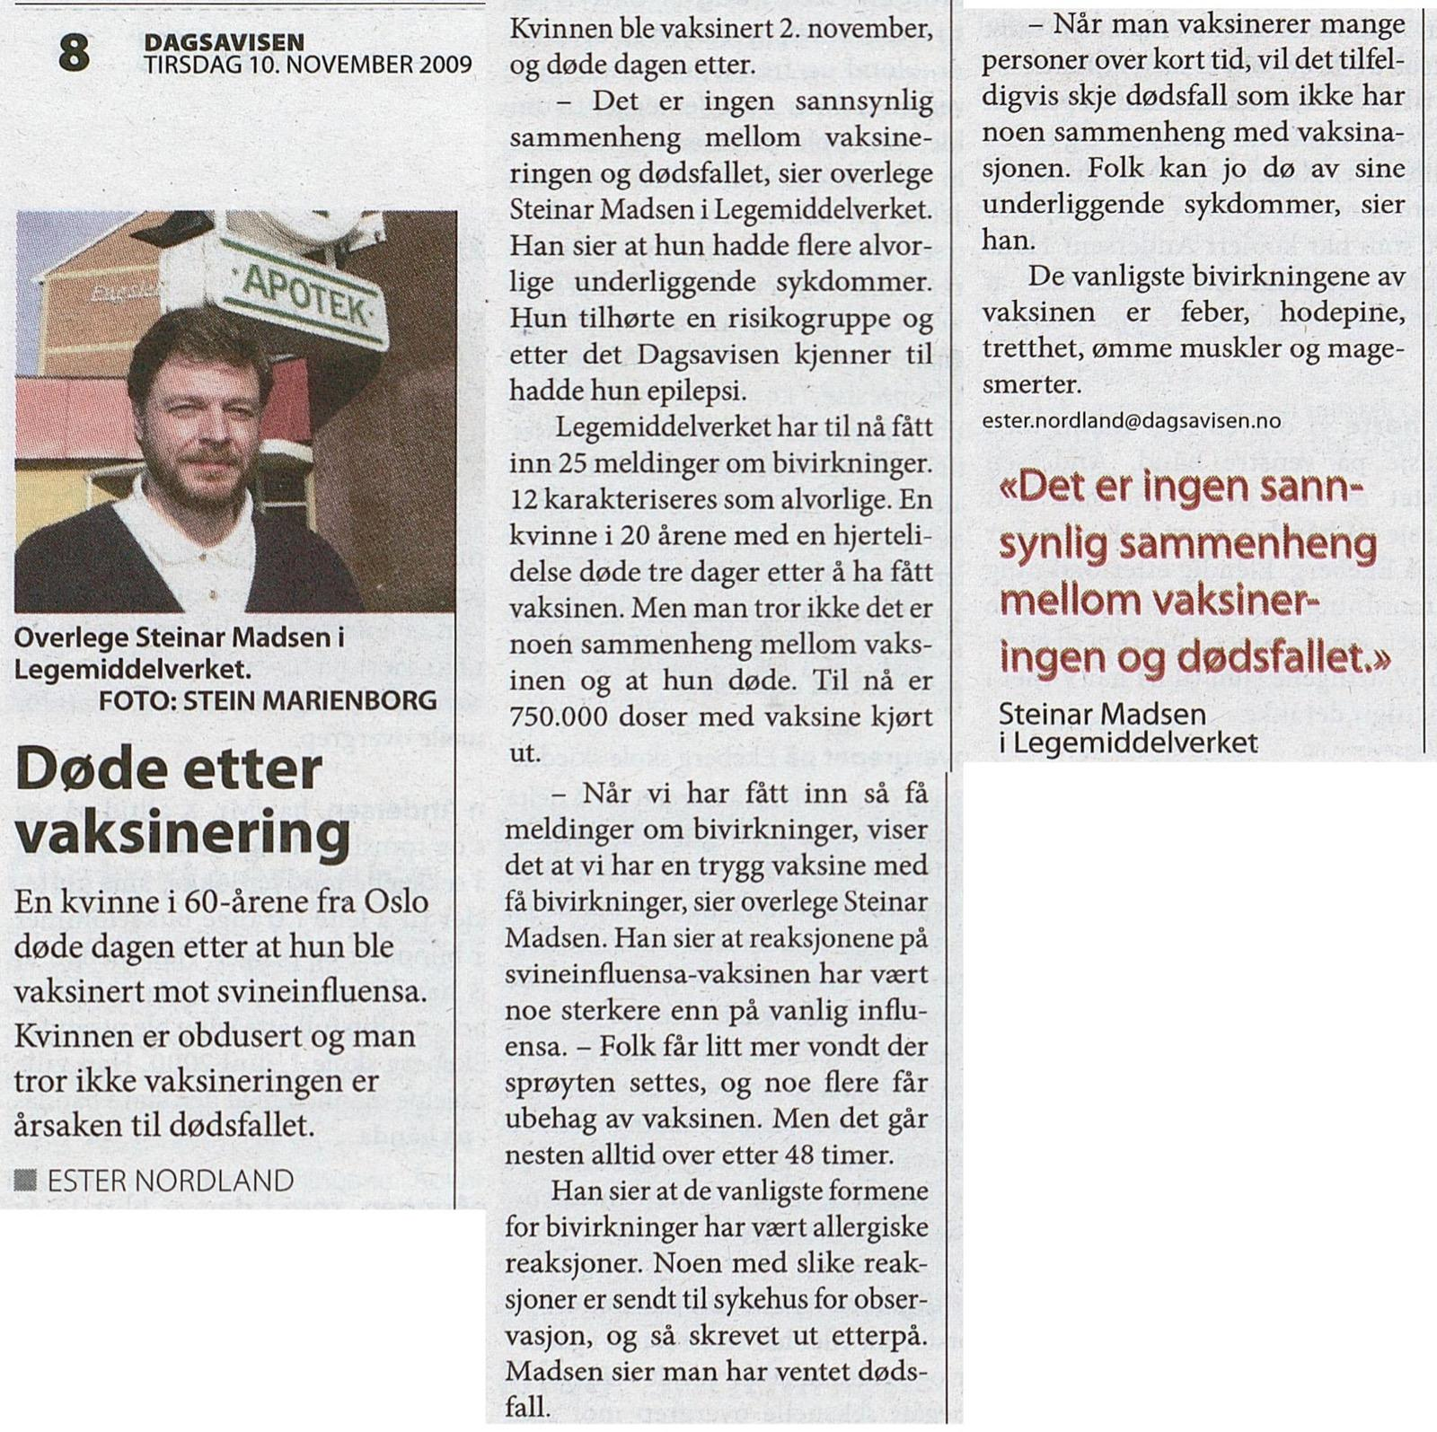
Madsen «No death due to vaxx in 2009»

Slide 8
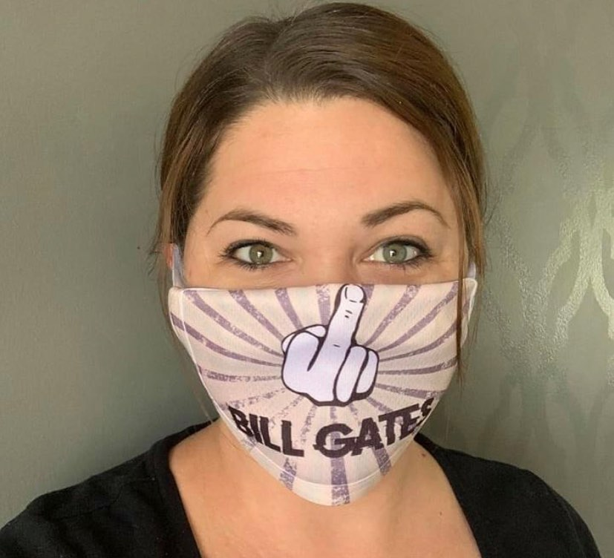
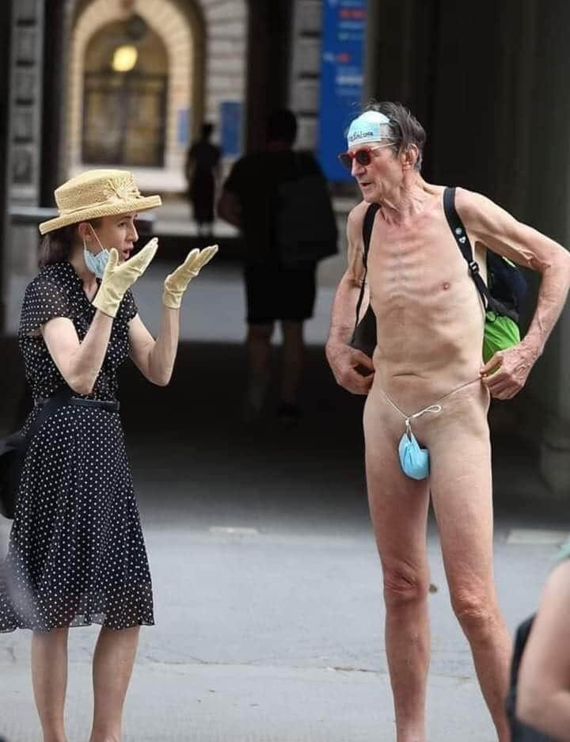
The mask hoax

Slide 9
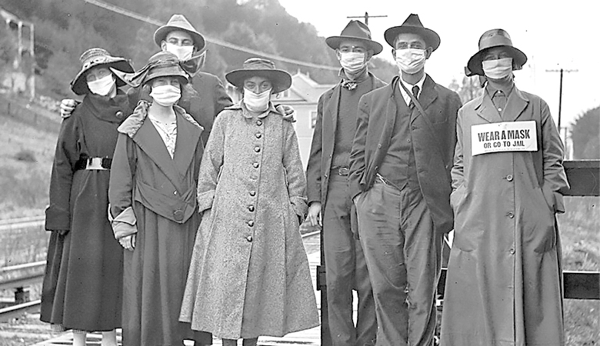
The mask hoax

Slide 10
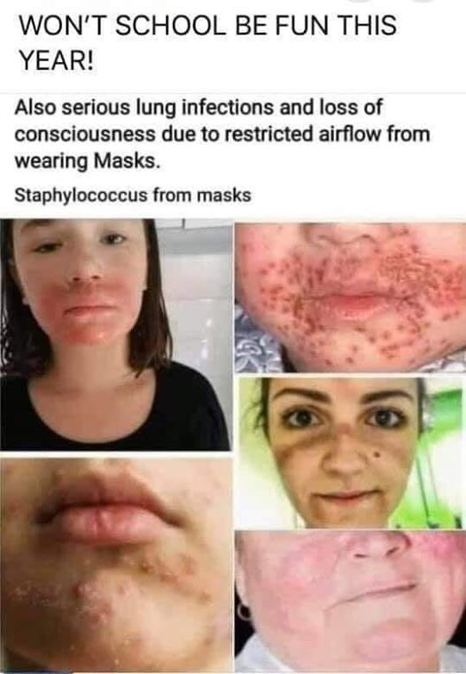
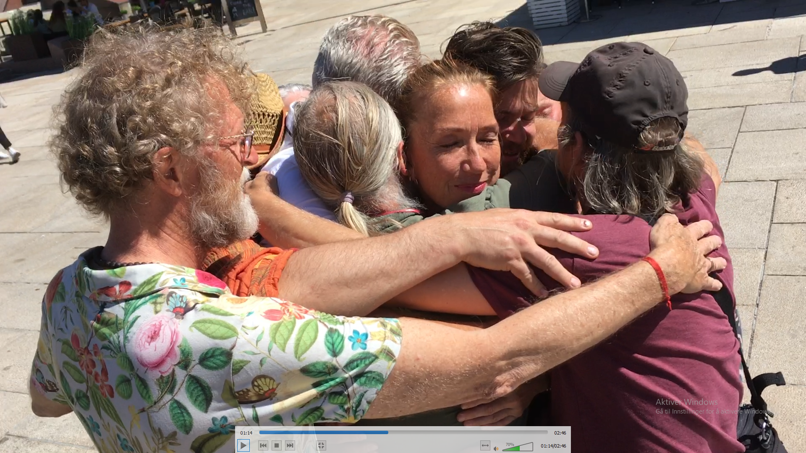
No to MASKS !

Slide 11
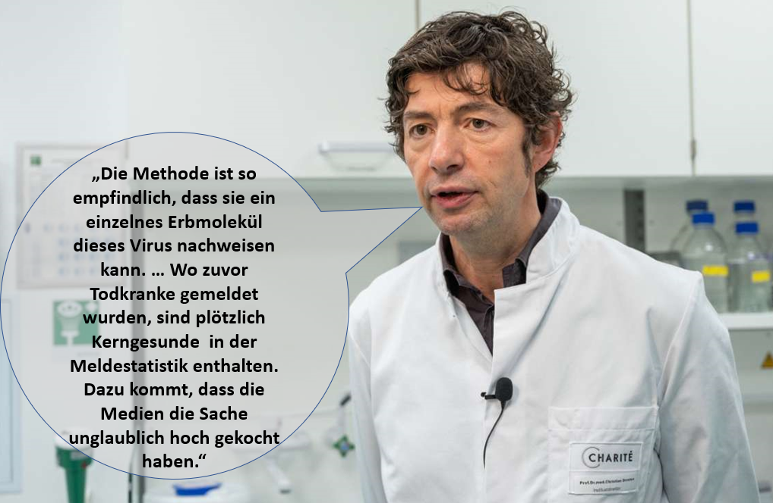
Test Hoax

Slide 12
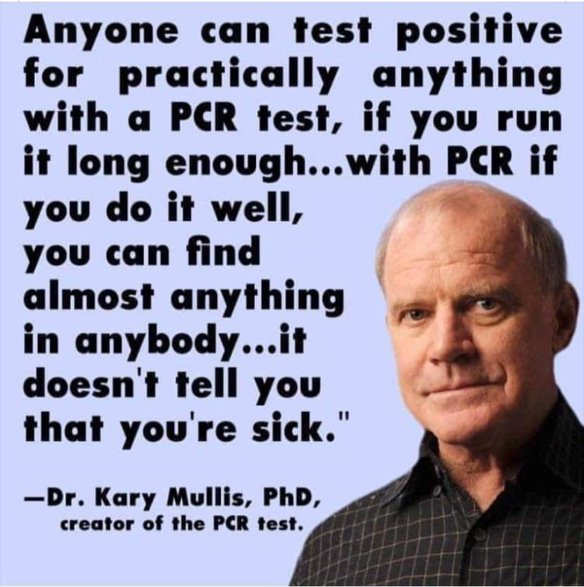
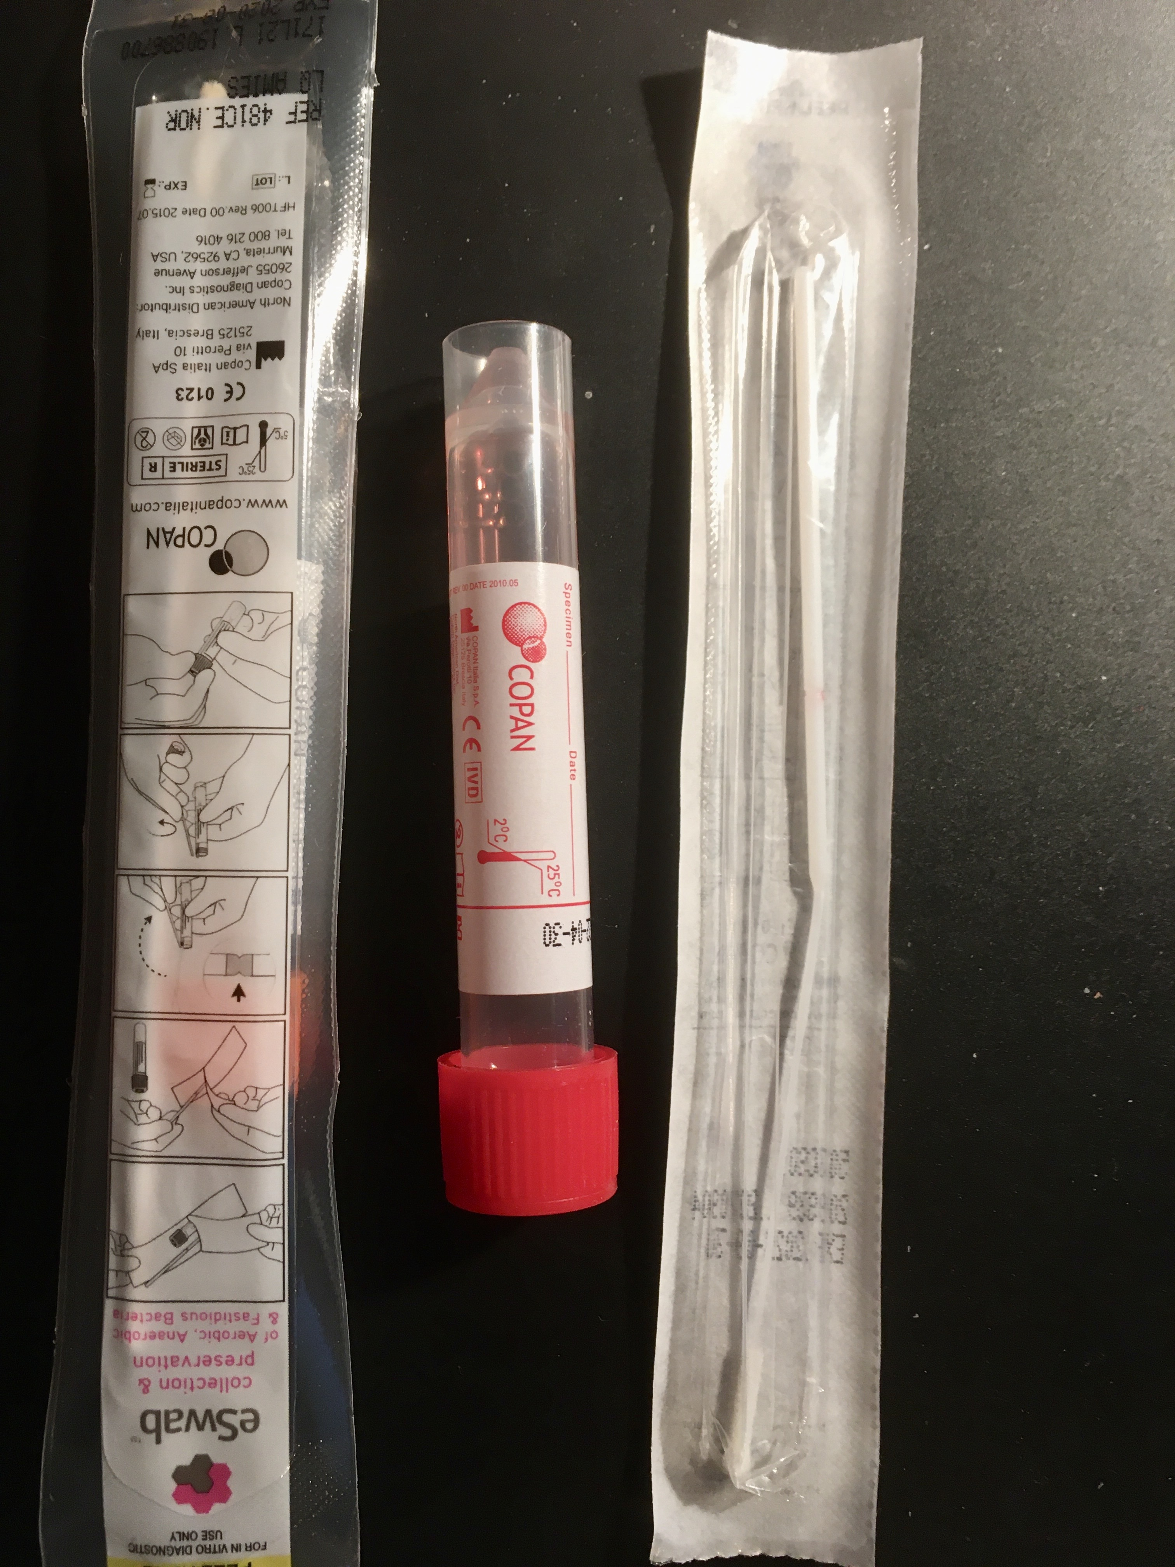
The swabs

Slide 13
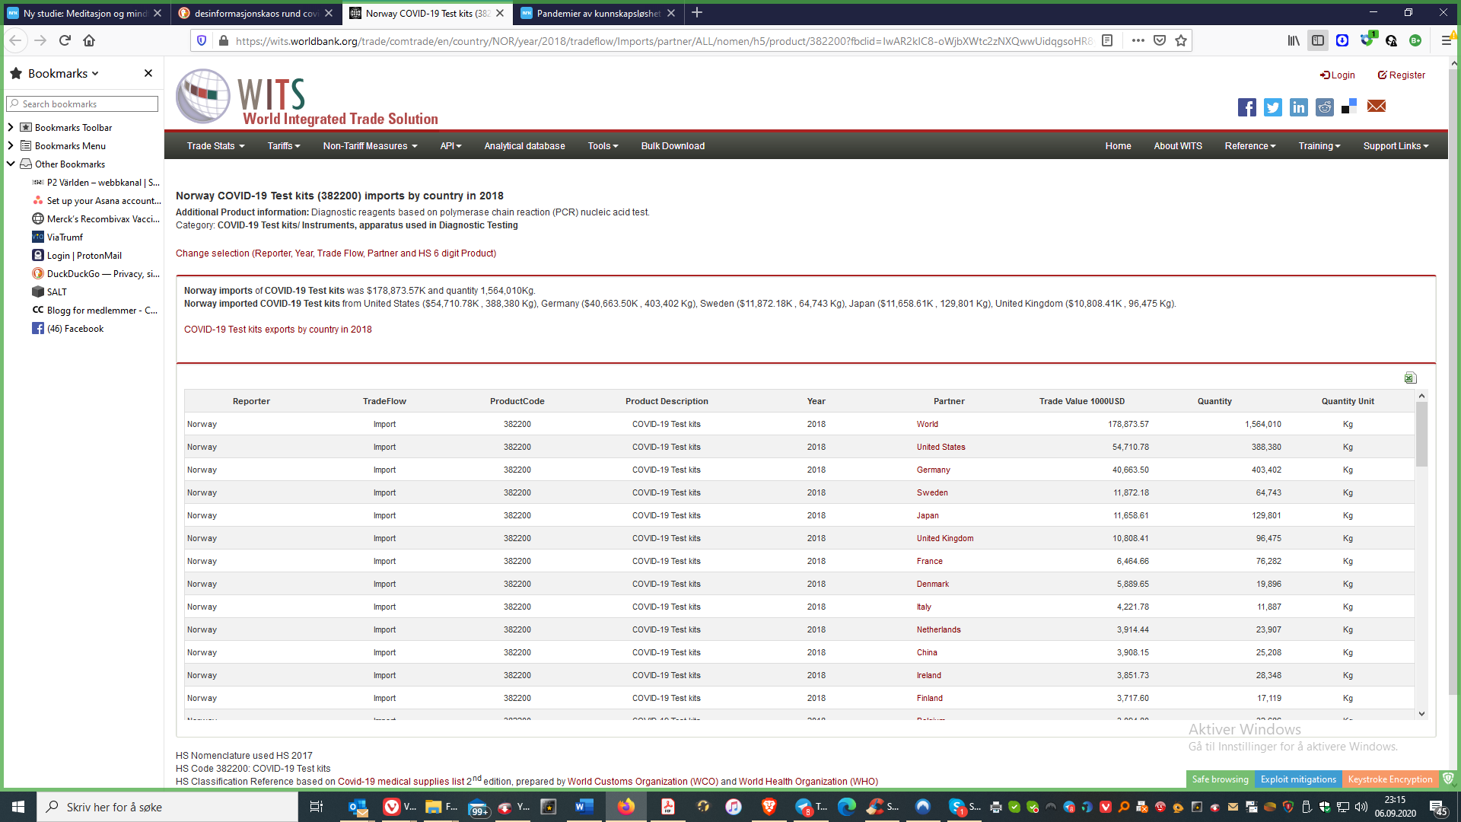
Norway bought PCR Tests in 2017

Slide 14
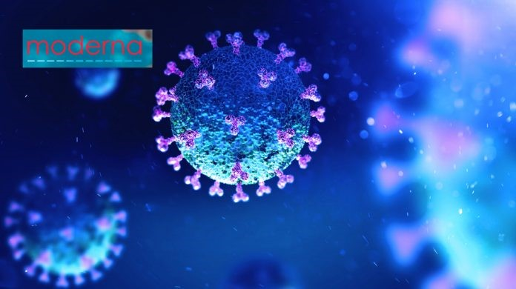
Both, PCR tests and Vaccine-studies are pure fraud.
see the proof onwww.thehighwire.com, EP. 192

Slide 15
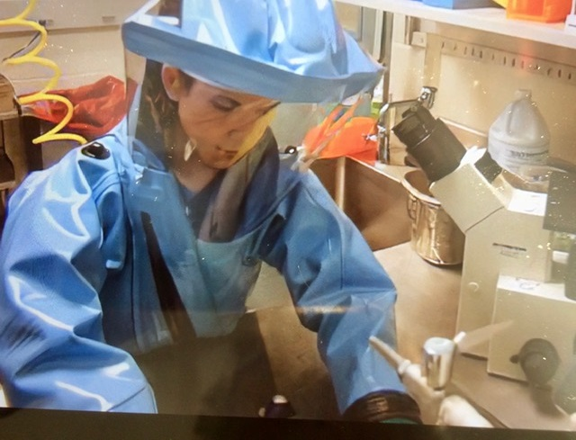
Keep the distance!

Slide 16
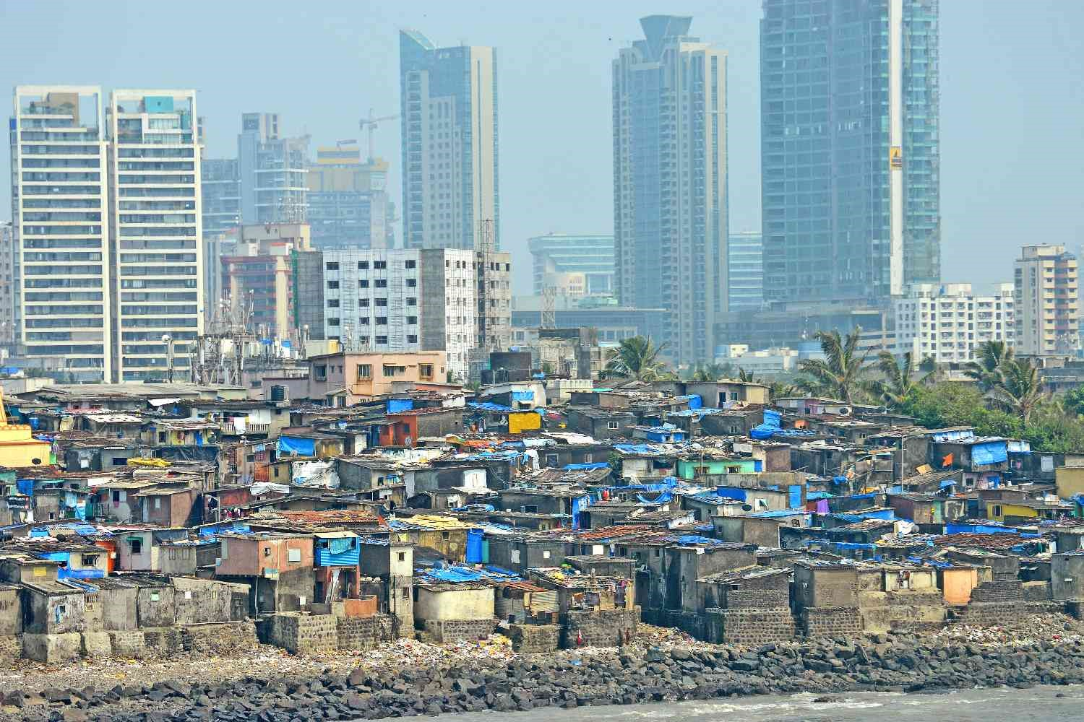
Distance does not work

Slide 17
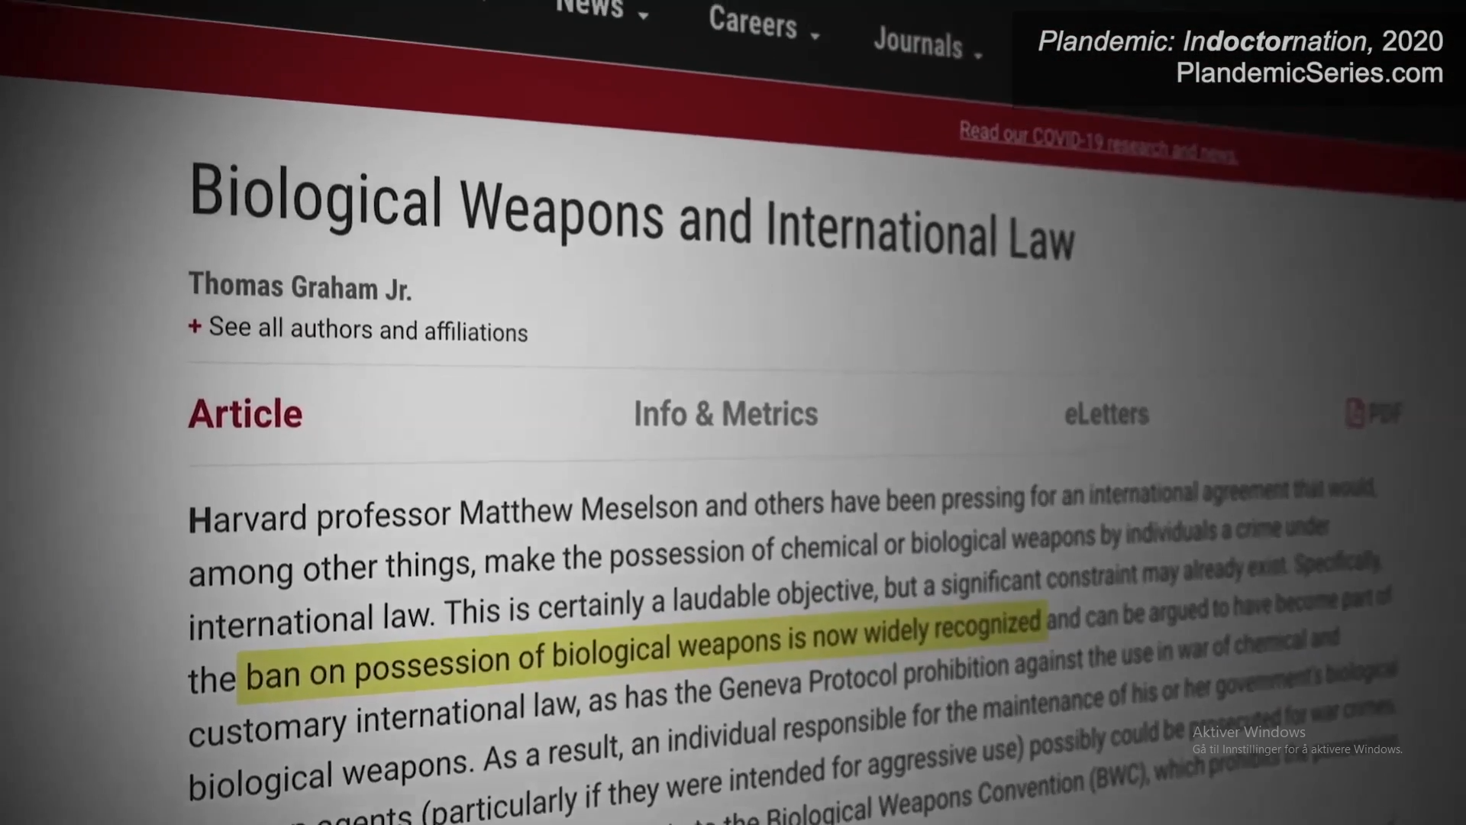
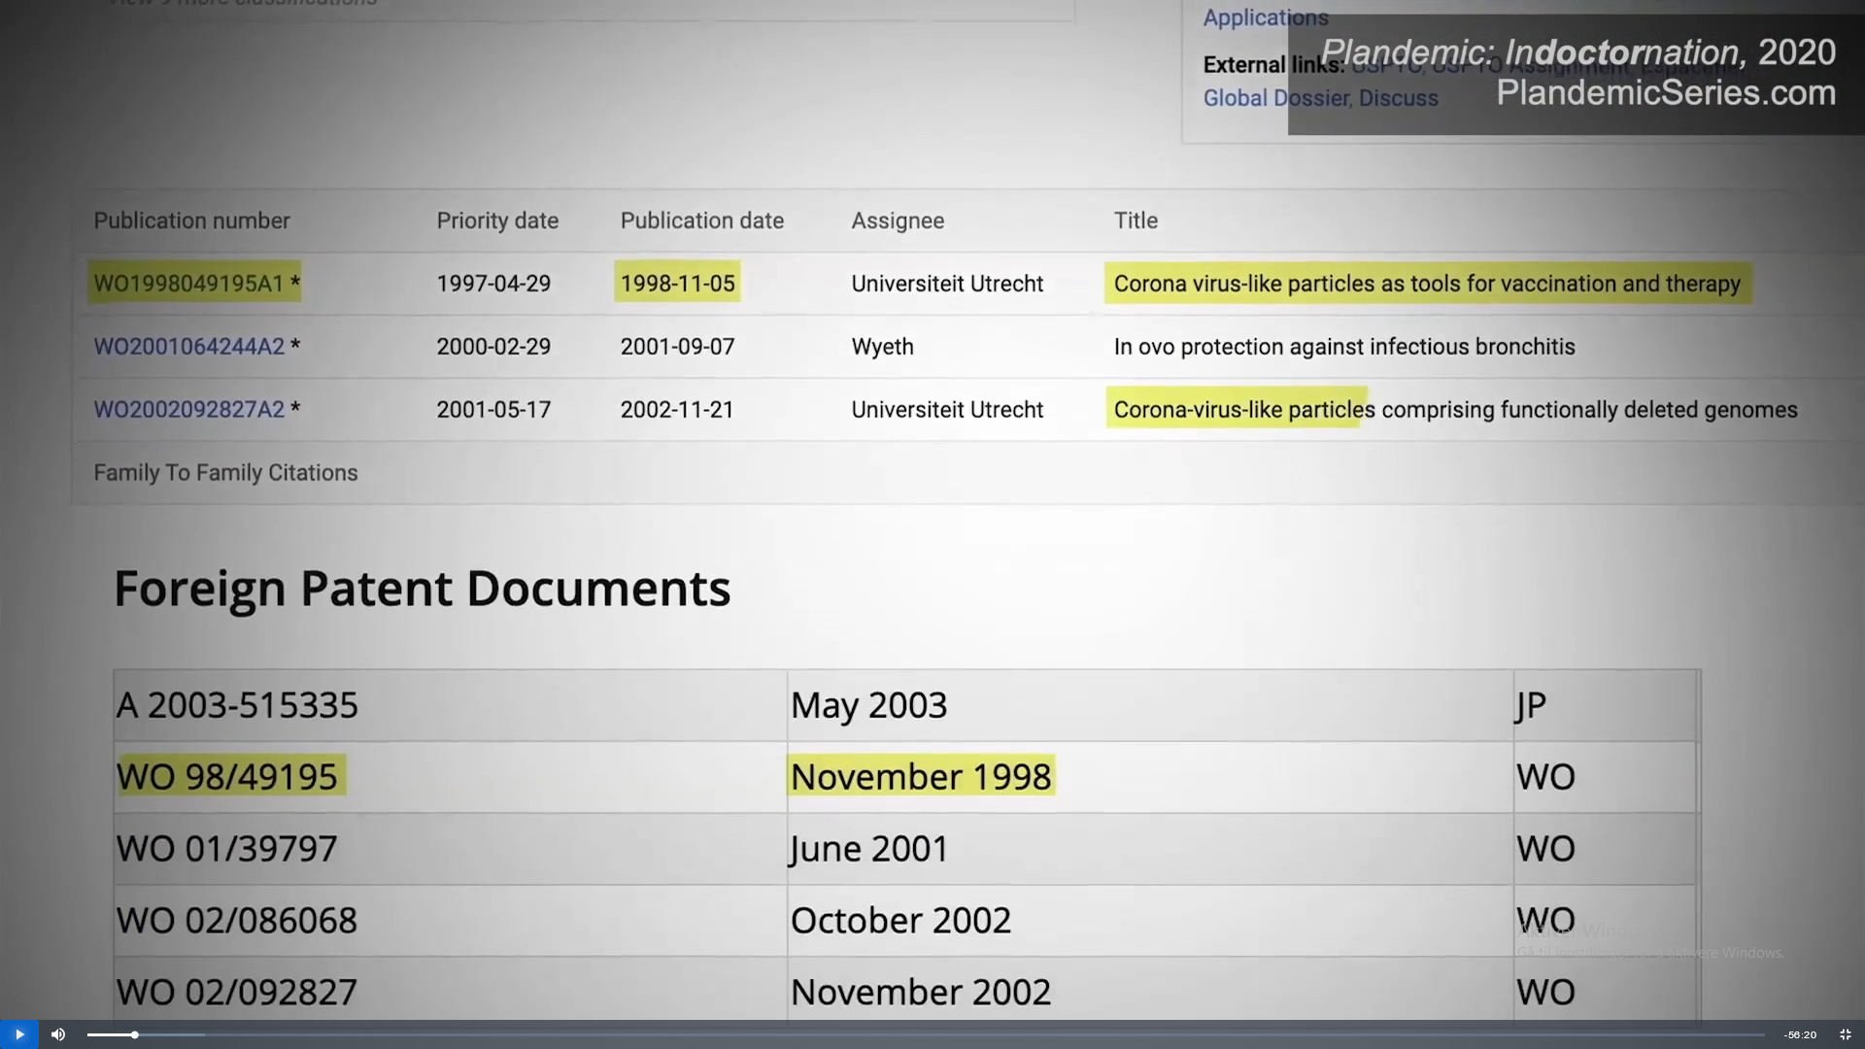
Patents on Corona tests and therapies from 1998

Slide 18
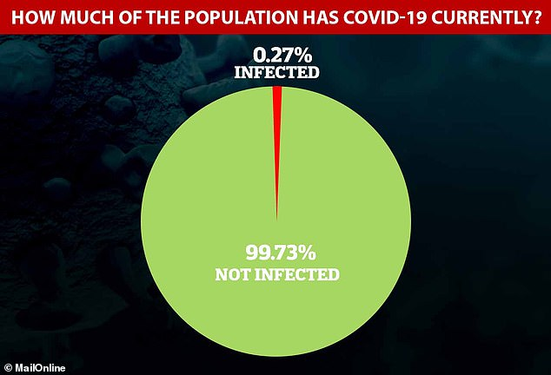
Fear is the virus

Slide 19
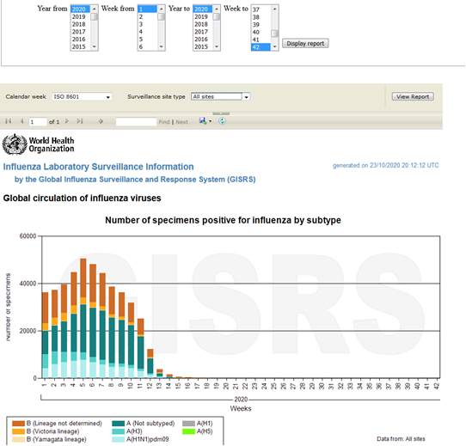
Where is the flue?

Slide 20

New Study Found 80% of COVID-19 patients were Vitamin D Deficient
But this information is censored by the “fact checkers”

Slide 21
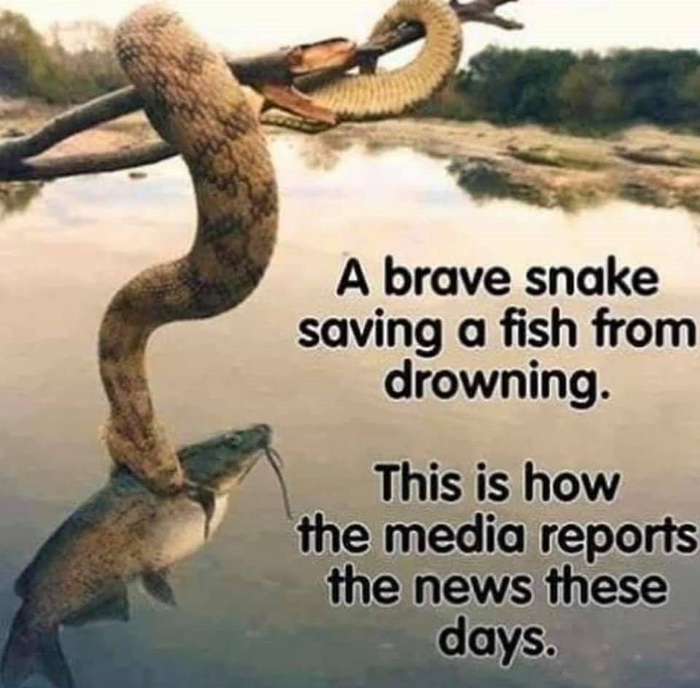
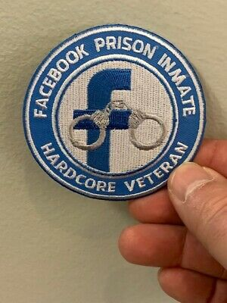
The press is lying

Slide 22
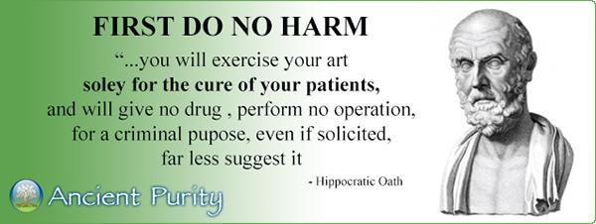

Slide 23

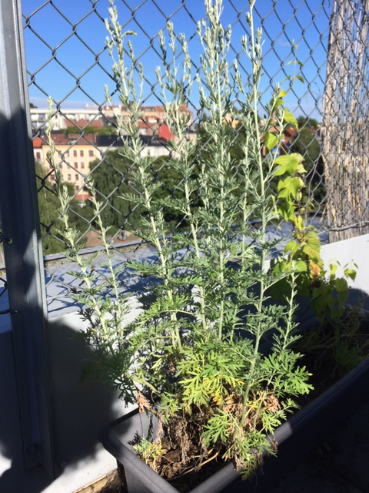
The ban on all medicines, but «Vaxx»

Slide 24
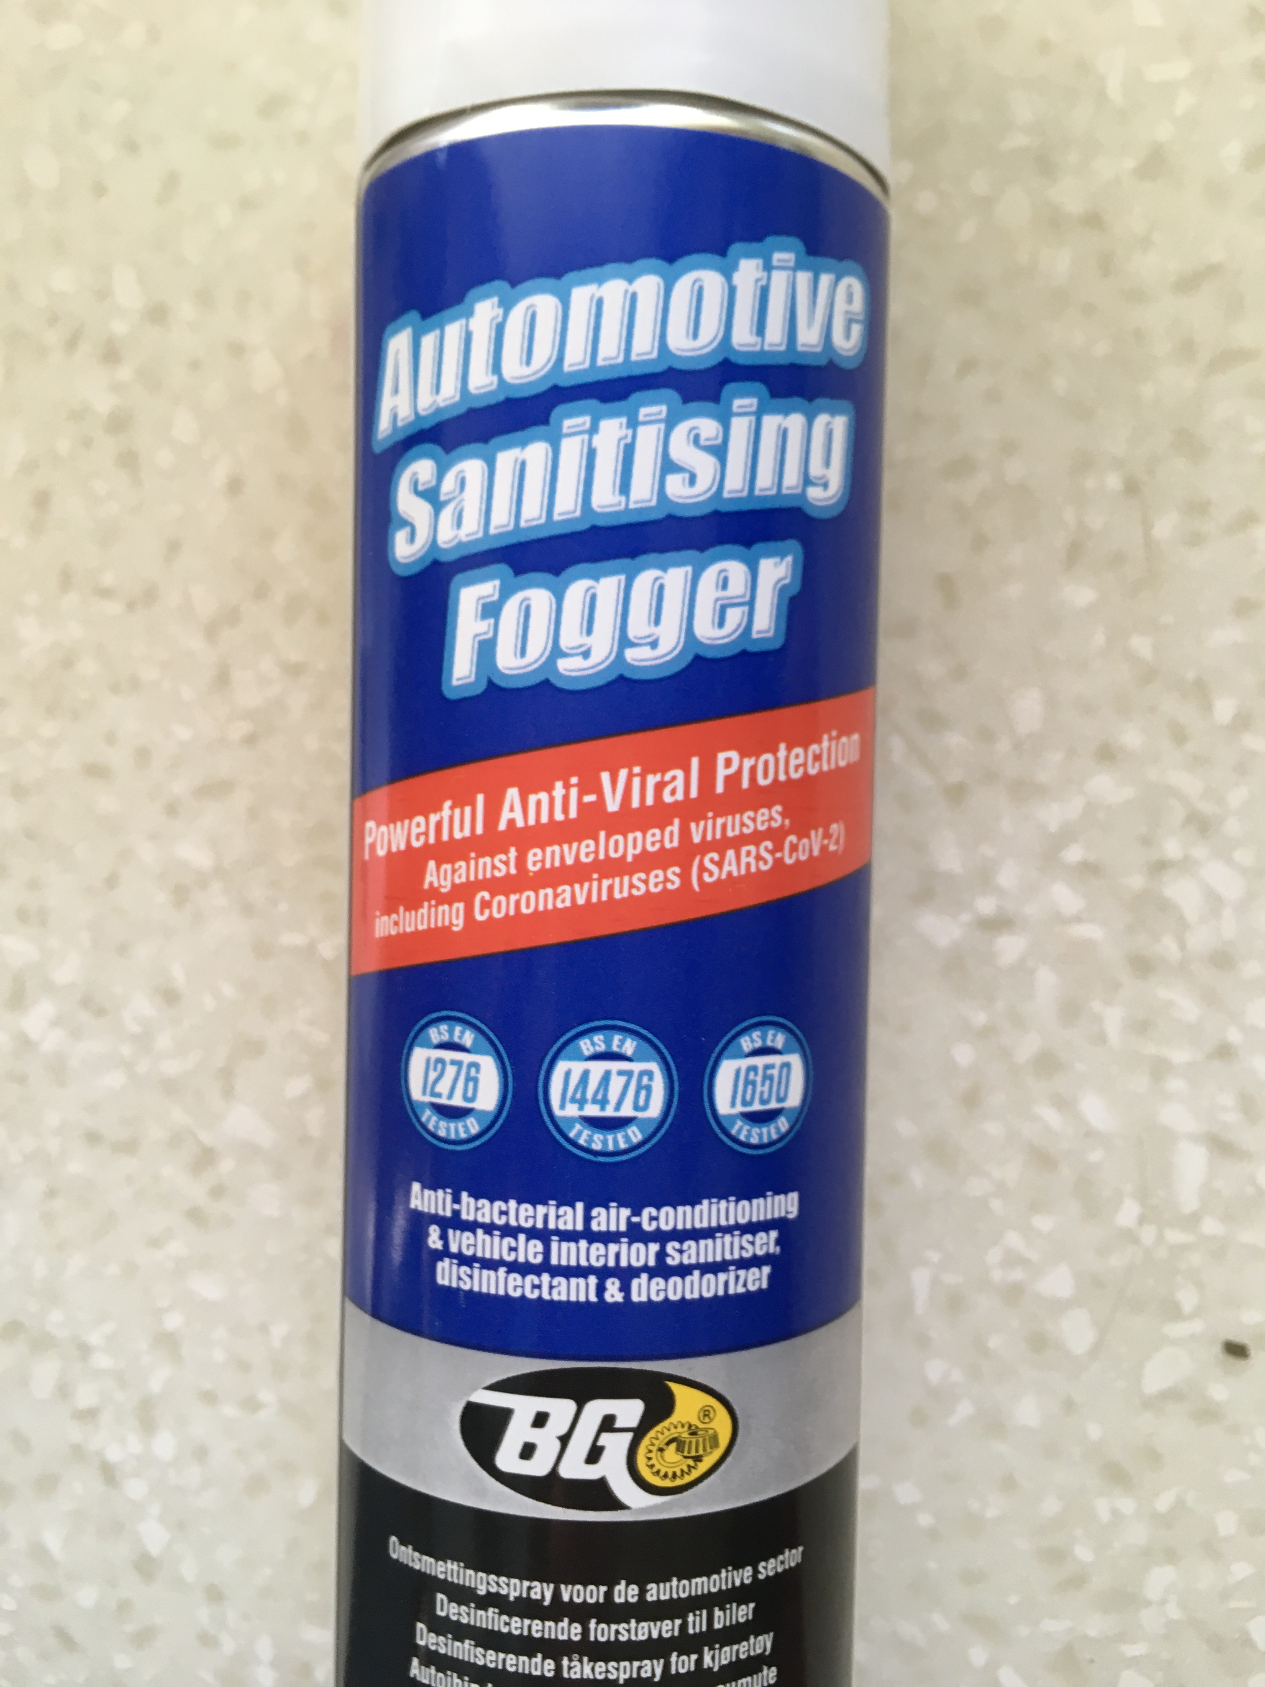
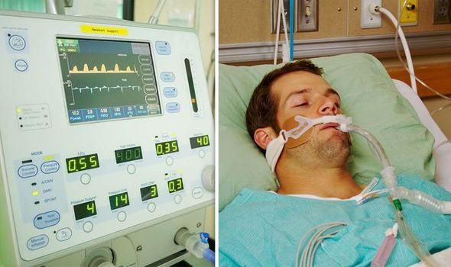
Wrong Medicine

Slide 25
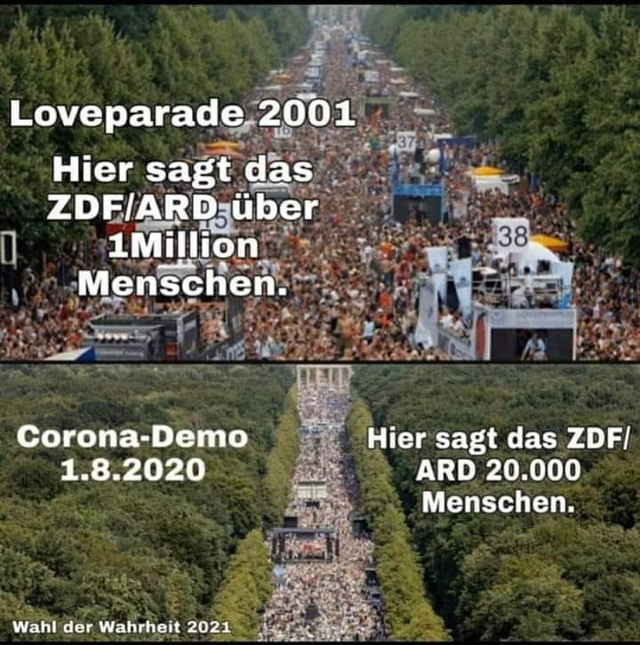
The press is lying

Slide 26
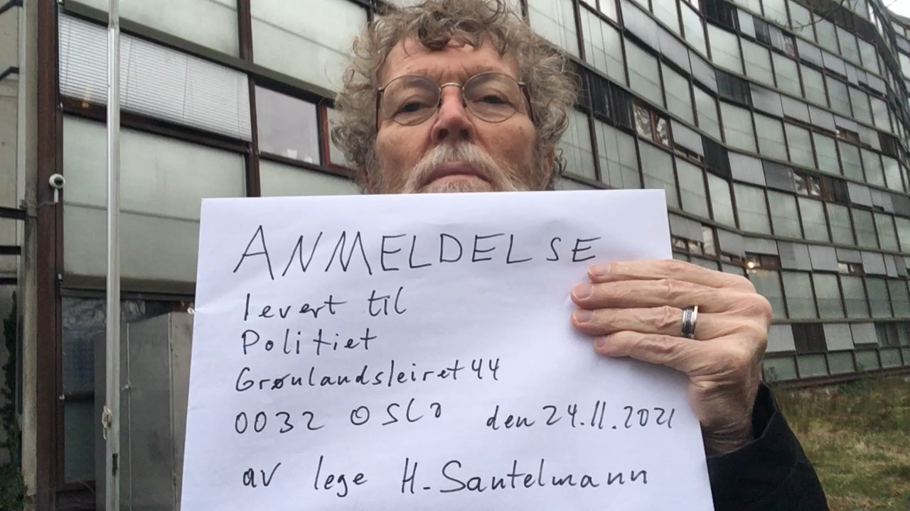
24/11-21, I have reported fact checkers and journalists in Norway to the police for spreading fear with fake news (Par.186)

Slide 27
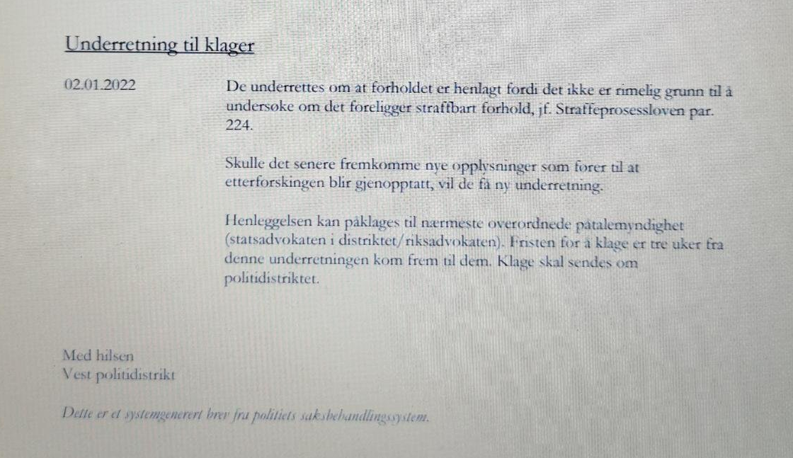
29/11-21, 20 persons in Bergen have reported journalists in Norway to the police for spreading fear with fake news (Par.186)
“The report has been dismissed because there is no reasonable reason”

Slide 28
Framing on TV and 10 newspapers
01.04.2020, Faktisk.no: Retired MD is spreading fake news about corona virus on FB
I et Facebook-innlegg kommer en pensjonert lege med feilinformasjon om coronaviruset. Innlegget ble mye spredt da en tidligere skuespiller delte det med sine 59.000 følgere.

Slide 29

A young fact-checker

Slide 30
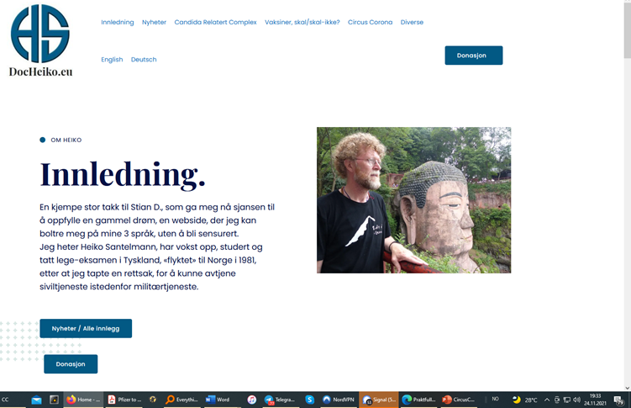
No censorship yet here:

Slide 31
HCQ is effective for COVID-19 when used early: analysis of 142 studies
Covid Analysis, October 20, 2020 (Version 16, November 14, 2020), https://hcqmeta.com/
• HCQ is effective for COVID-19. The probability that an ineffective treatment generated results as
positive as the 142 studies to date is estimated to be 1 in 62 billion (p = 0.000000000016).
• Early treatment is most successful, with 100% of studies reporting a positive effect and an
estimated reduction of 64% in the effect measured (death, hospitalization, etc.) using a random
effects meta-analysis, RR 0.36 [0.28-0.46].
• 100% of Randomized Controlled Trials (RCTs) for early, PrEP, or PEP treatment report positive
effects, the probability of this happening for an ineffective treatment is 0.002.
• There is evidence of bias towards publishing negative results. 89% of prospective studies report
positive effects, and only 74% of retrospective studies do.
• Significantly more studies in North America report negative results compared to the rest of the
world, p = 0.002.

Slide 32
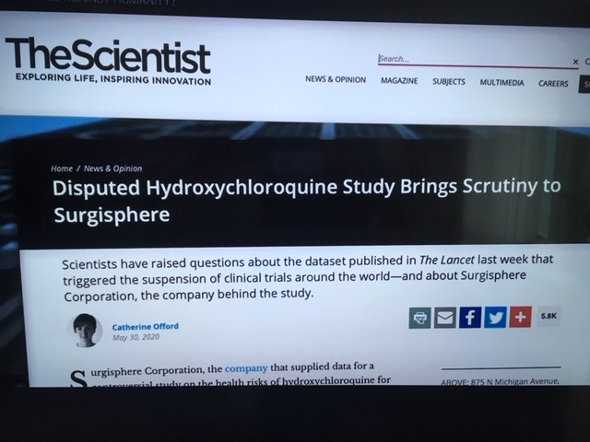

Slide 33
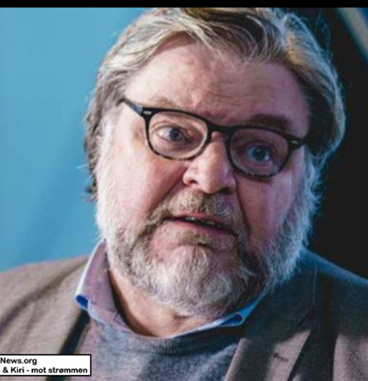
The judicial system is broken
On june 8-21,I reported Madsen for man-slaughter to the police, but it was dismissed. Now, 30 weeks and a minimum of 370 (official numbers) deaths later, I delivered a new demand on injunction to stop the deathly jabs. – Today, I received a strange and stupid answer from the same judge, Rune Klausen, who for 2 years has blocked all attempts to settle the covid- crimes by peacfully methodes.

Slide 34
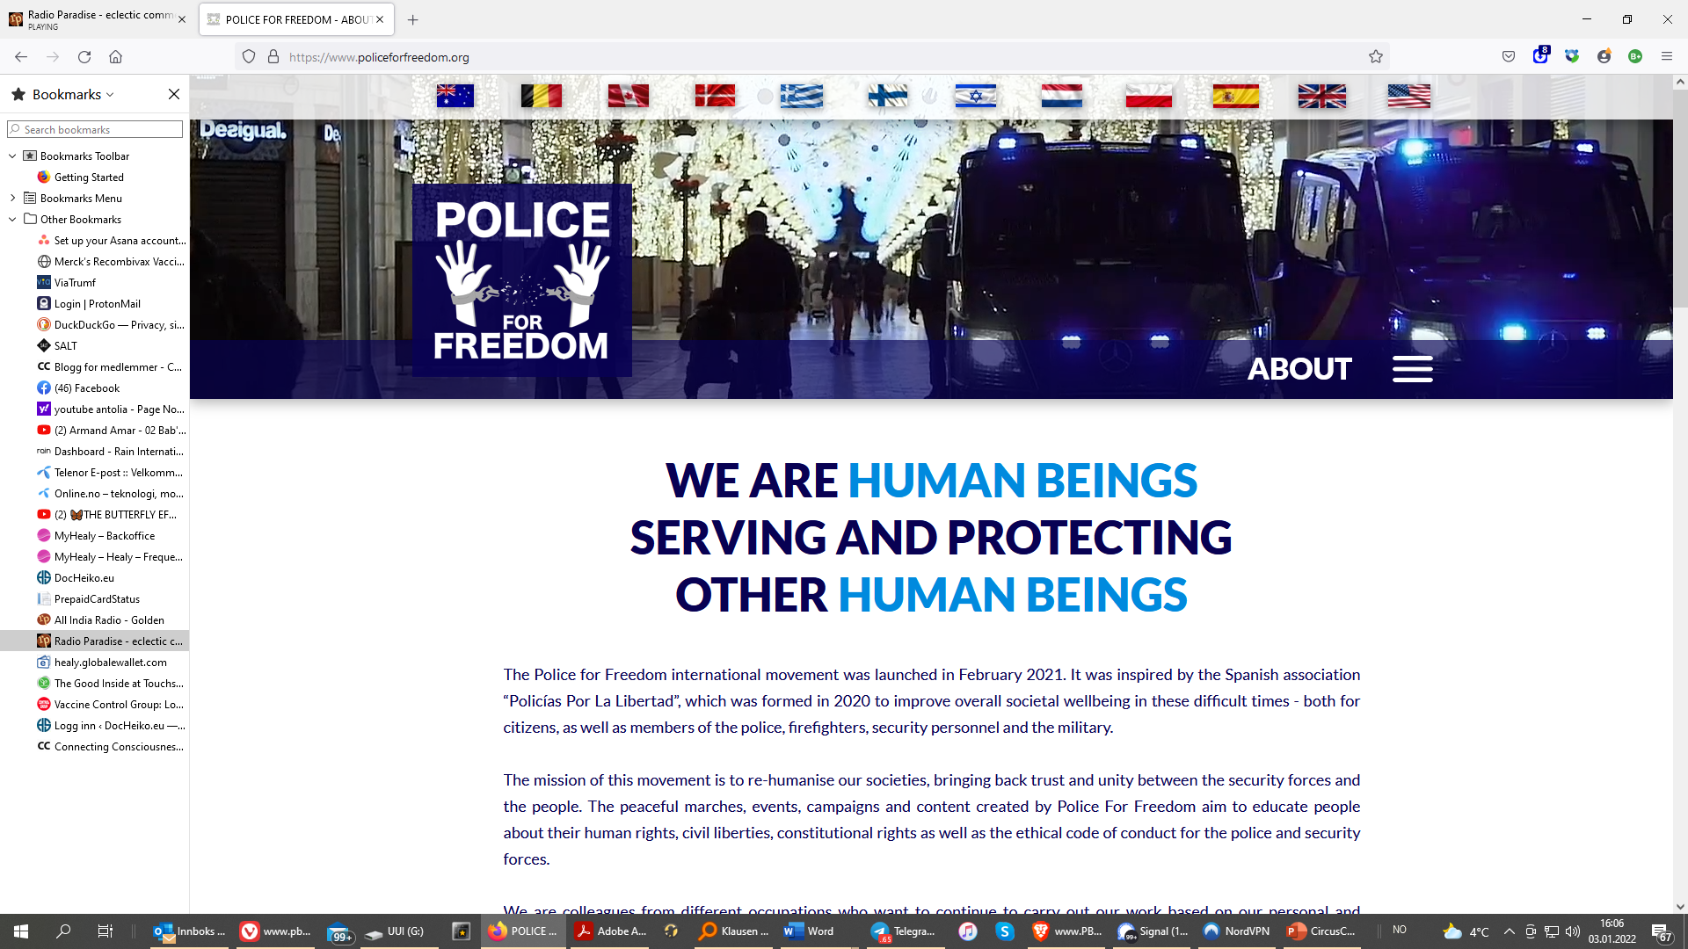
The judicial system is broken

Slide 35
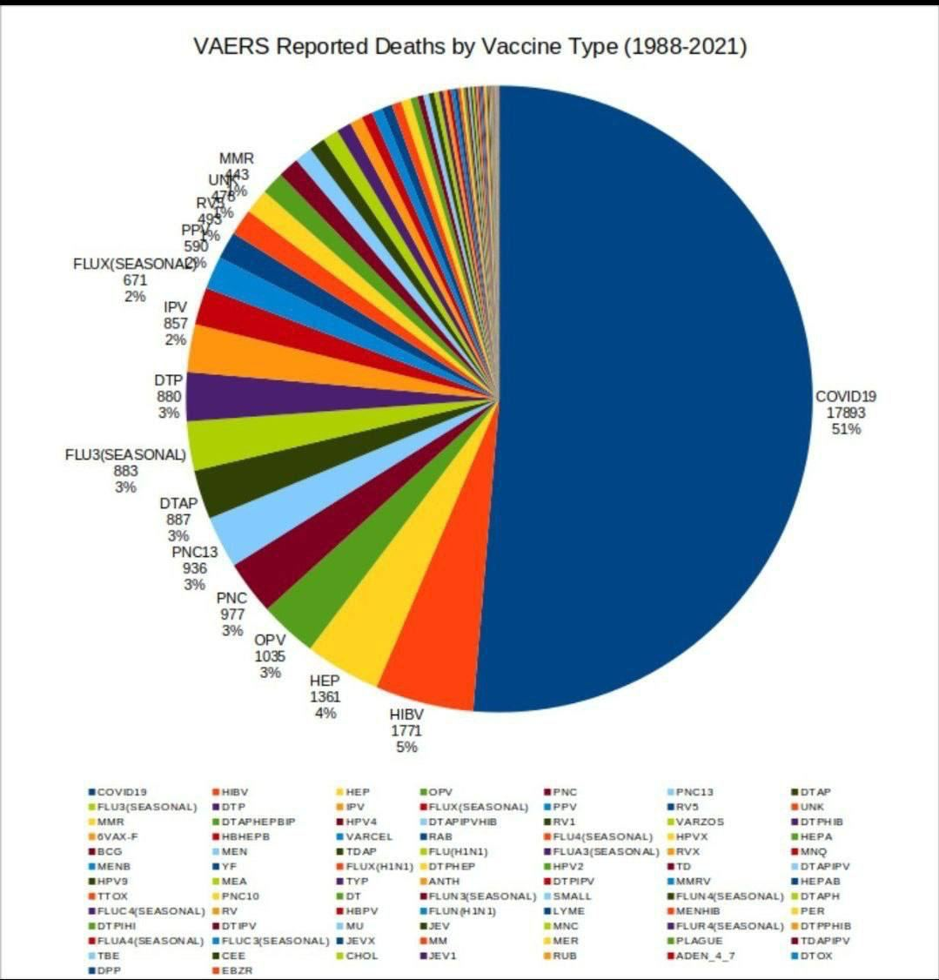
The Medical system is broken

Slide 36
The Medical system is broken
Official German Government data suggests the Fully Vaccinated will develop Acquired Immunodeficiency Syndrome by the end of January 2022
https://dailyexpose.uk/2022/01/02/german-gov-data-suggests-fully-vaccinated-developing-ade/

Slide 37
You got chipped!
This Pfizer patent application was approved August 31st, 2021, and is the very first patent that shows up in a list of over 18500 for the purpose of remote contact tracing of all vaccinated humans worldwide who will be or are now connected to the “internet of things" by a quantum link of pulsating microwave frequencies of 2.4 gHz or higher from cell towers and satellites directly to the graphene oxide held in the fatty tissues of all persons who’ve had the death-shot.
Read that AGAIN!
https://patentimages.storage.googleapis.com/68/80/73/6a17a66e9ec8c5/US11107588.pdf

Slide 38
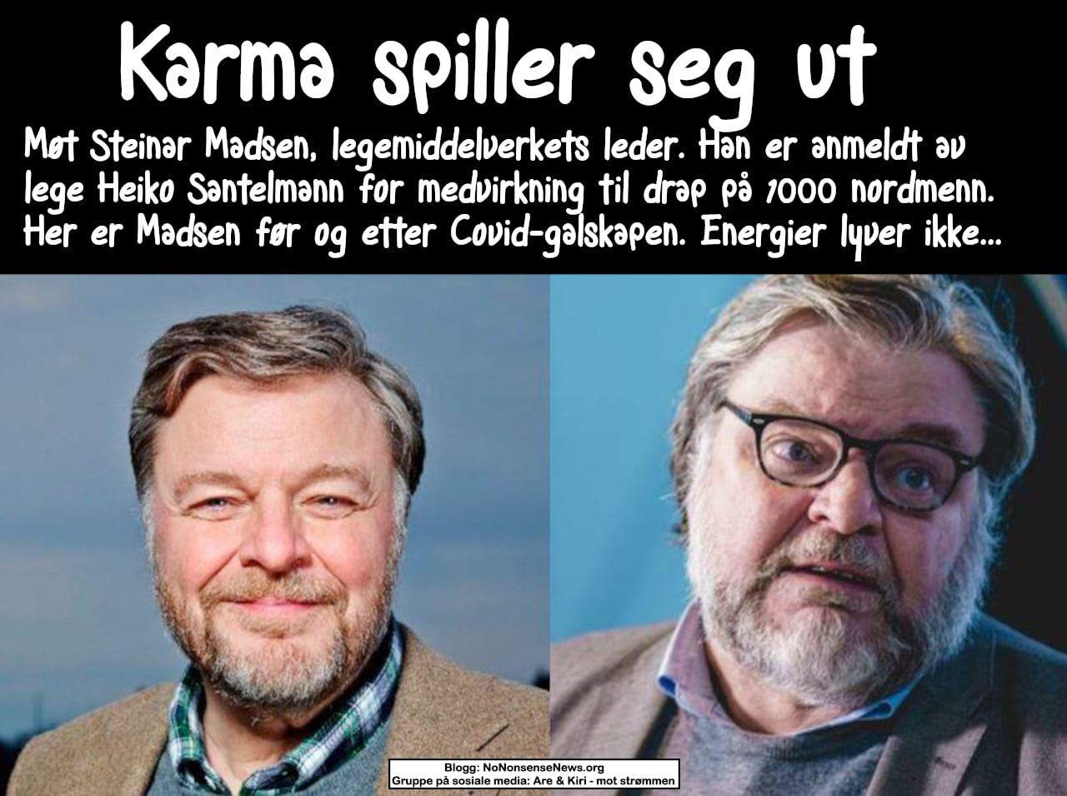
Madsen Not looking good

Slide 39
Pfizer and Moderna’s “95% effective” vaccines — let’s be cautious and first see the full data
BMJ, November 26, 2020
“Only full transparency and rigorous scrutiny of the data will allow for informed decision making, argues Peter Doshi”:
HTTPS://BLOGS.BMJ.COM/BMJ/2020/11/26/PETER-DOSHI-PFIZER-AND-MODERNAS-95-EFFECTIVE-VACCINES-LETS-BE-CAUTIOUS-AND-FIRST-SEE-THE-FULL-DATA/

Slide 40
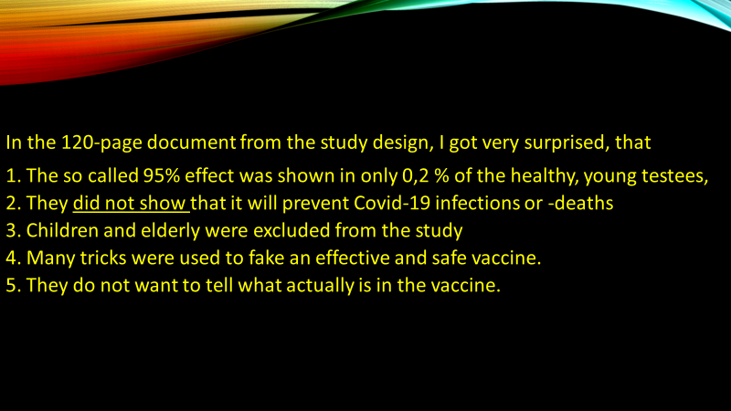

Slide 41

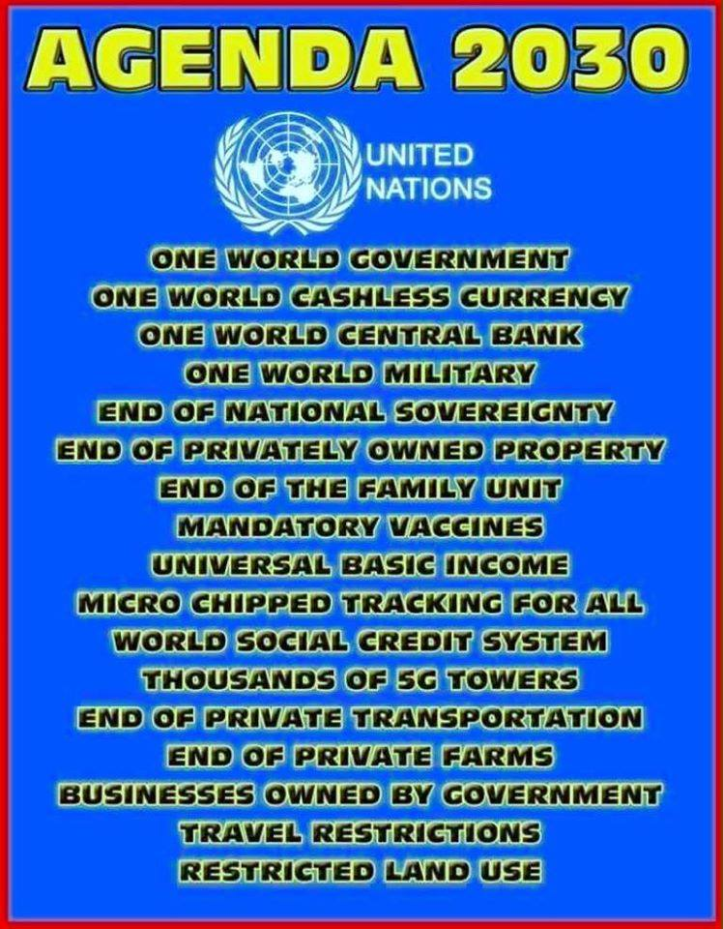
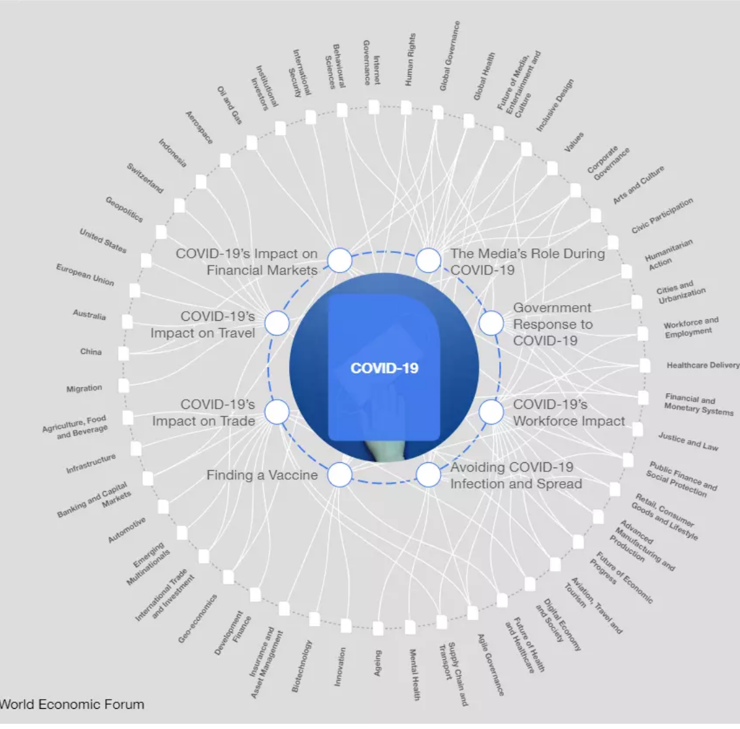
WHY?- Their Plan

Slide 42
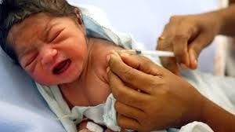
This Is murder!

Slide 43
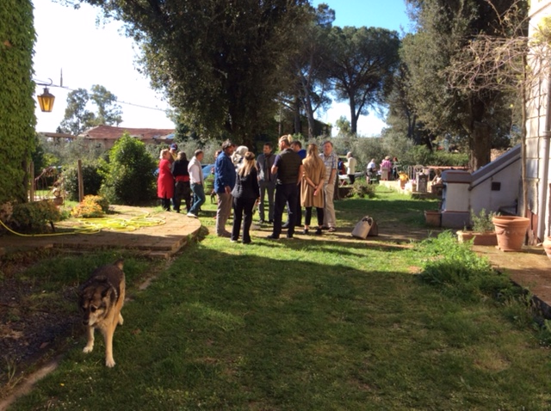
My «shedding» experiences

Slide 44
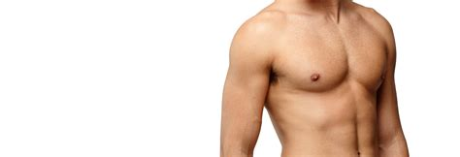
My «shedding» experiences

Slide 45
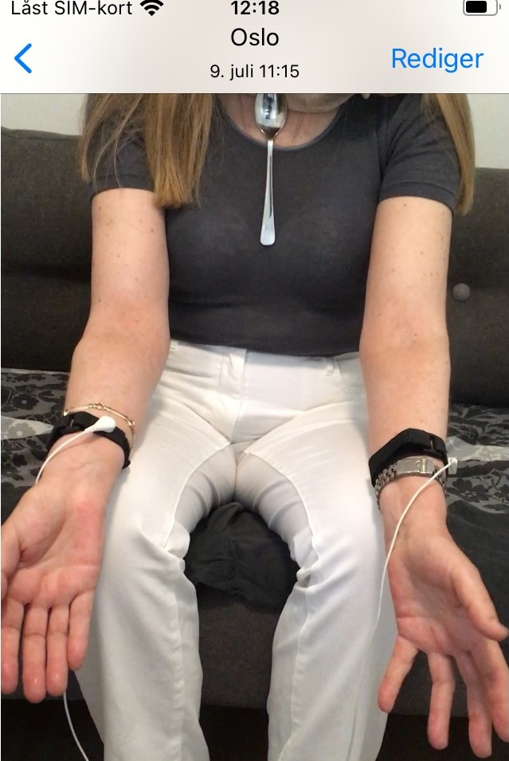
My «shedding» experiences

Slide 46

My «shedding» experiences
1. 11 year old
Cat and 75 yo
25 yo
Me
Frequencys
NAC
Accusation for fear-spreading

Slide 47
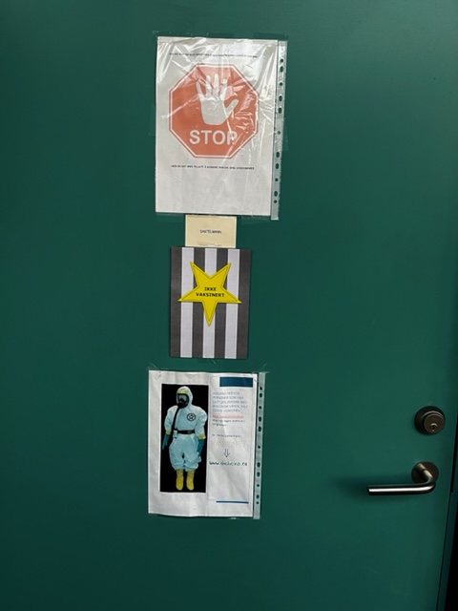
Local resistance

Slide 48
I recommend to
start thinking before it’s illegal.
If someone wants to force you to wear a mask, tell them OK, but only if they can show you a published study, proving it does not harm you, (since several court decisions concluded they might harm). If they can not provide such a study, take their name and address, so you can sue them personally, if something should happen to you/your child.
Taking a test is voluntary. Since the virus is supposed to jump between persons for over 1 meter, it should be sufficient to spit on the cotton-swab. Too many got sick after taking this swab a long way into their nose.- It just makes no sense.
Before considering to take a vaccine, you should demand for a complete list of ingrediencies and to take allergy-tests for each ingredience.

Slide 49
…and I wonder:
Why did Gates and his conspiracy terrorists invest billions in developing vaccines, that
can be given by a cotton-swab in the nose?
can sterilize men, women and lead to abortion?
can control our health and mind and
link us up to a net cloud?
Why, if they do not want to use that???

Slide 50


Slide 51
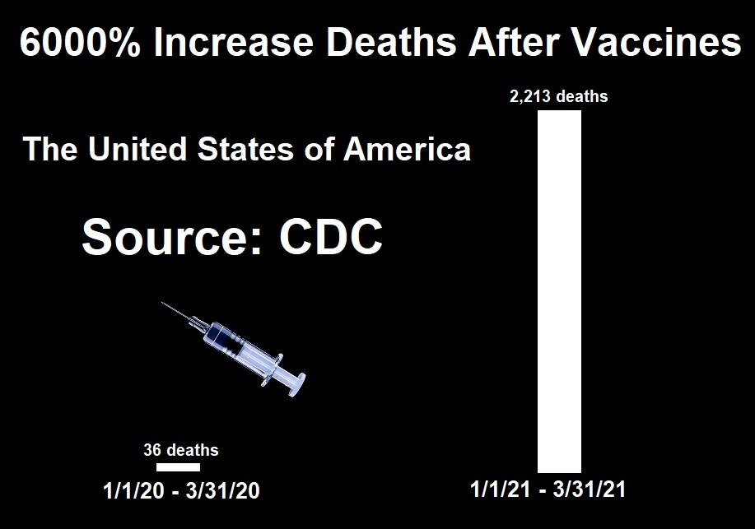
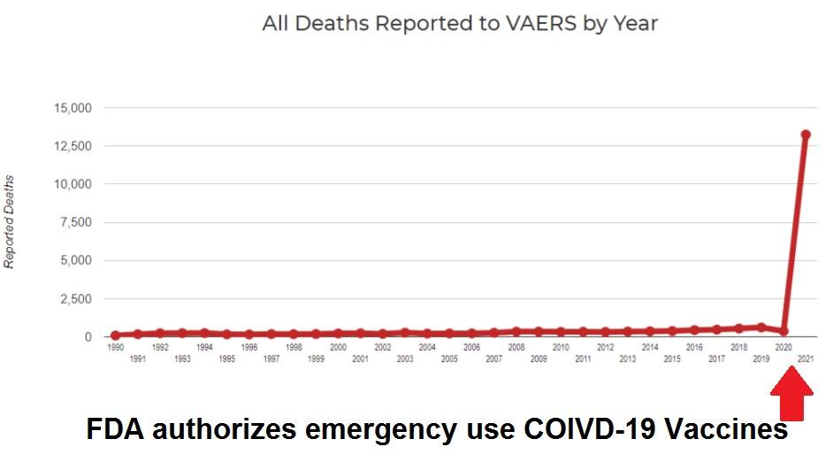
C-Vaxx Kill more than
All vaxx Before

Slide 52
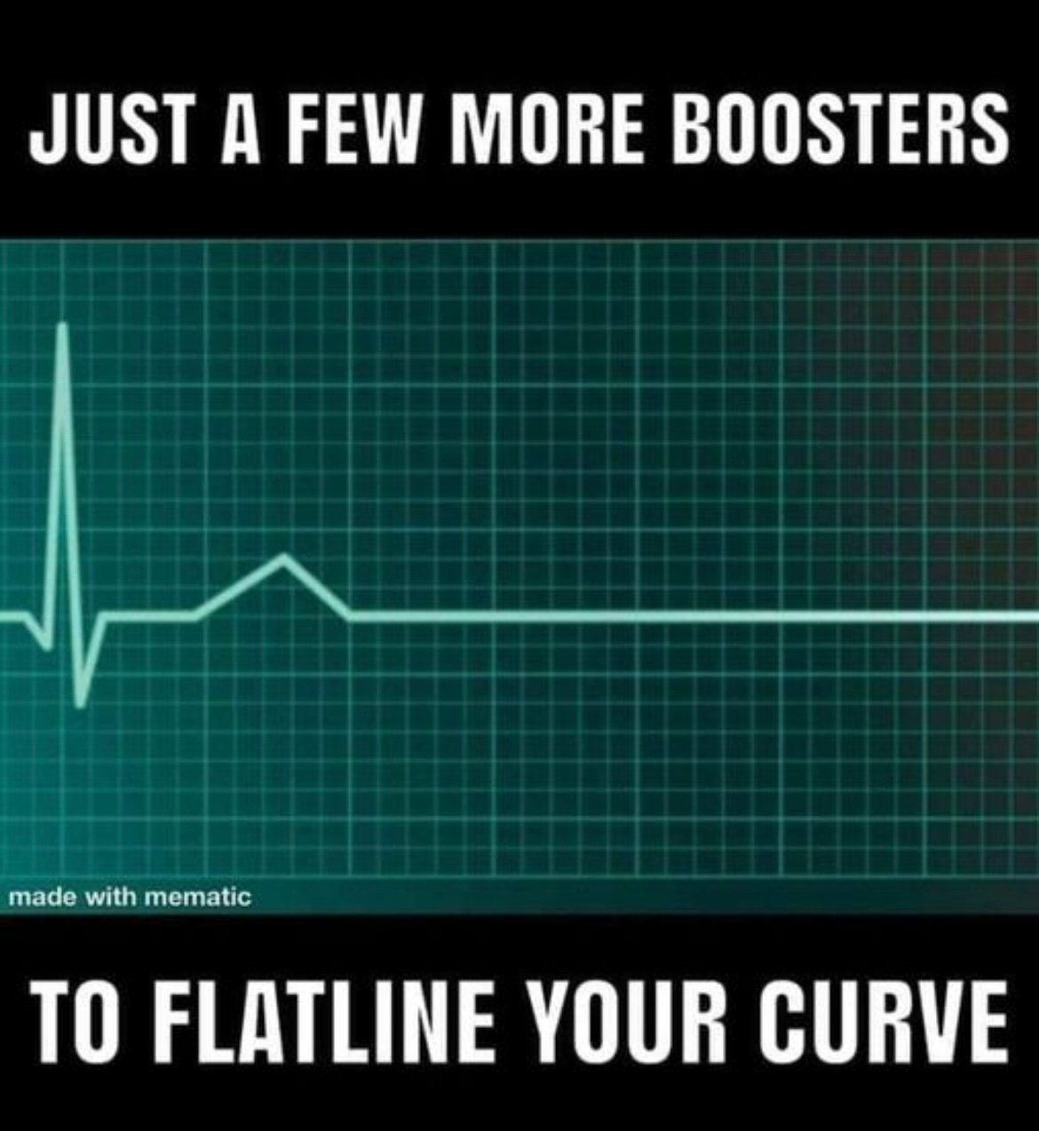
How many more boosters?

Slide 53
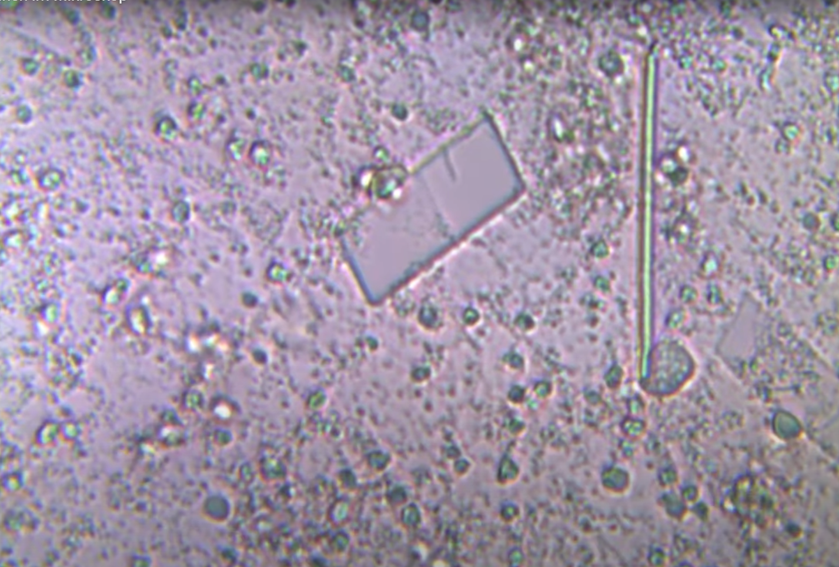
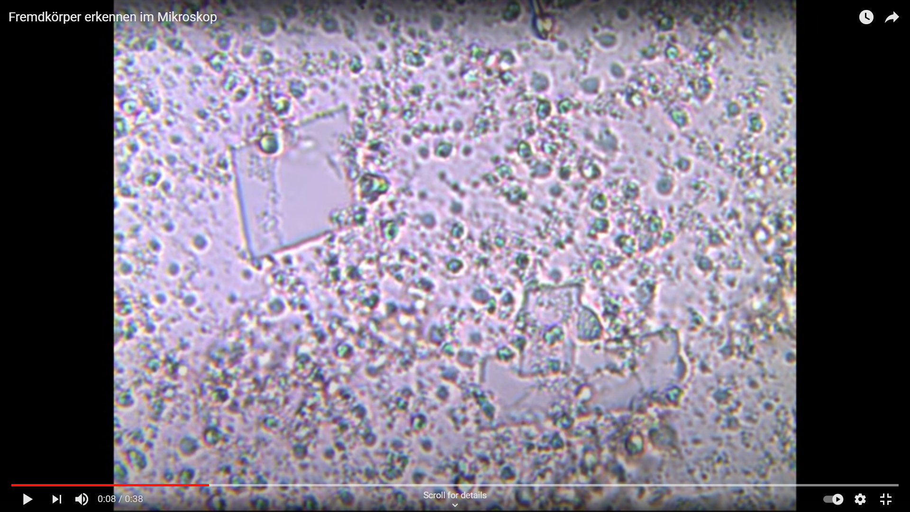
Metall pieces i Pfizers vaxx

Slide 54

Hemmelig Innhold

Slide 55

HCQ for students?

Slide 56


Slide 57
Norwegian Groups
Telegram: Magnetisert?
Face Book: Fri Helse
www.Lovoghelse.no
www.c19fakta.no
https://binders.info/
https://worldhealthforum21.com
https://worldcouncilforhealth.org
https://www.freedomtravelalliance.com
http://vaccfree.love
https://covid19criticalcare.com/
www.EFVV.eu
www.WorldFreedomAlliance.org

Slide 58
How to get them
The vaccine manufacturers have been given an "out-of-prison card", which means they can harm and kill as many people as they want, without having to stand up for it. BUT: this immunity does not apply, when they do not
1. declare all possible side effects
2. declare all ingrediences
3. present new safety studies every 2 years
4. provide an adequate record of adverse reactions through Vaccine Adverse Event Reporting System (VAERS).

Slide 59


Slide 60
«Sammensetning av Comirnaty
Virkestoff er covid-19 mRNA-vaksine som kalles tozinameran. Etter fortynning inneholder hvert hetteglass 6 doser à 0,3 ml med 30 mikrogram tozinameran.
Andre innholdsstoffer er:
  ((4-(hydroksybutyl)azanediyl)bis(heksan-6,1-diyl)bis(2-heksyldekanoat) (ALC-0315)
  2-[(polyetylenglykol)-2000]-N,N-ditetradekylacetamid (ALC-0159)
  1,2-Distearoyl-sn-glycero-3-fosfokolin (DSPC)
  kolesterol
  kaliumklorid
  kaliumdihydrogenfosfat

Slide 61
ALC-0315 - Echelon Biosciences
ALC-0315 is an ionizable lipid which has been used to form lipid nanoparticles for delivery of RNA. ALC-0315 is one of the components in the BNT162b2 vaccine against SARS-CoV-2 in addition to ALC-0159, DSPC, and cholesterol. This is a reagent grade product, for research use only.

Slide 62
PROOF of Intentional Premeditated Murder: DEPLOYMENT OF TOXIC VAX BATCHES
https://thephaser.com/2021/12/proof-of-intentional-vaxx-premeditated-murder /By Craig Paardekooper

Slide 63


Slide 64


Slide 65
PLEASE DO NOT GIVE UP FIGHTING FOR HUMANITY !
Thank you for your attention!
Follow me at www.DocHeiko.eu

